Slide 1




SEMI-AUTOMATIC QUALITY ASSURANCE (SAQA) MATLAB SCRIPT FOR ACR MRI PHANTOM
Jidi Sun^{1,2,3}, M. Barnes², P. Stanwell¹, J. Dowling³, F. Menk¹, P.B. Greer^{1,2}
¹ University of Newcastle, Newcastle, New South Wales, Australia.
² Calvary Mater Newcastle, Newcastle, New South Wales, Australia.
³ CSIRO Australian E-Health Centre, Brisbane, Queensland, Australia.
EPSM2013, Perth

Slide 2
Content
ACR MRI phantom background
SAQA Matlab Script
Manual QA vs. SAQA
How to make a better phantom

Slide 3
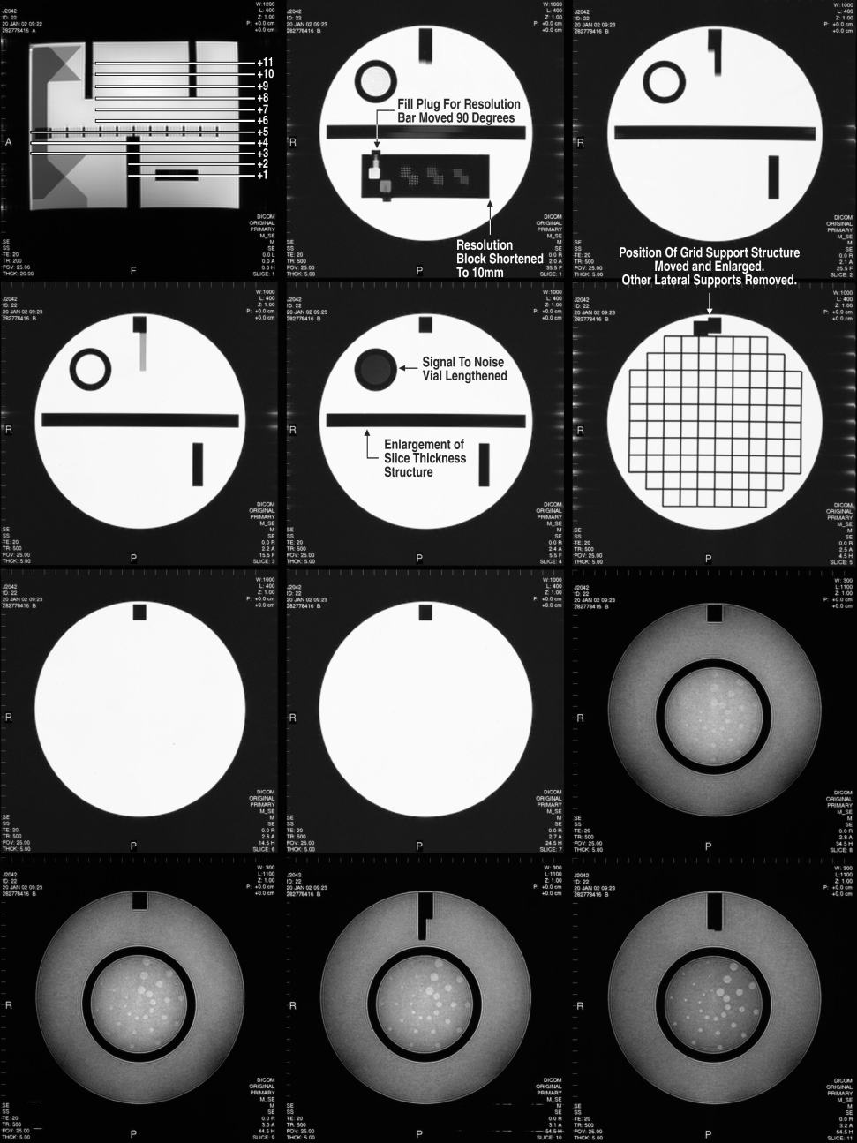
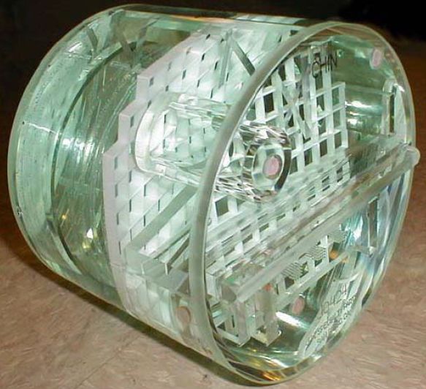
What is the ACR MR Phantom?
S 1
S 2
Localiser
S 3
S 4
S 5
S 6
S 7
S 8
American College of Radiology (ACR)
  148 cm length, 190 cm diameter
  10 mmol NiCl_{2,} 45 mmol NaCl
  T1 & T2 images
S 9
S 10
S 11

Slide 4
MR QA with ACR
S 1
S 2
Geometric distortion
High contrast spatial resolution
Slice thickness accuracy
Slice position accuracy
Image intensity uniformity
Ghosting
Low contrast object detectability
[B0 homogeneity, field drifting, RF coil check, inter-slice RF interference]
Localiser
S 3
S 4
S 5
S 6
S 7
S 8
S 9
S 10
S 11

Slide 5
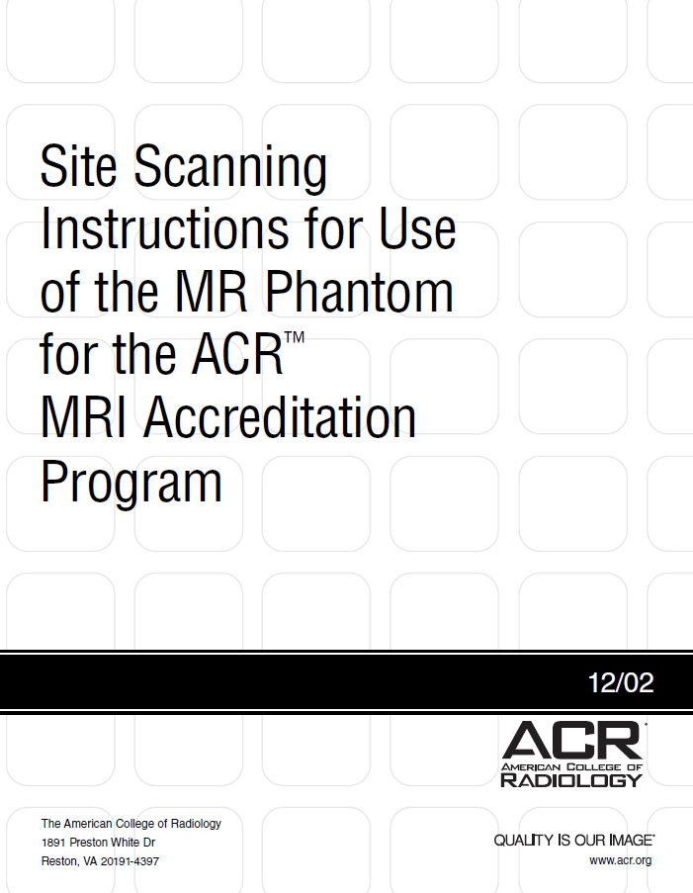
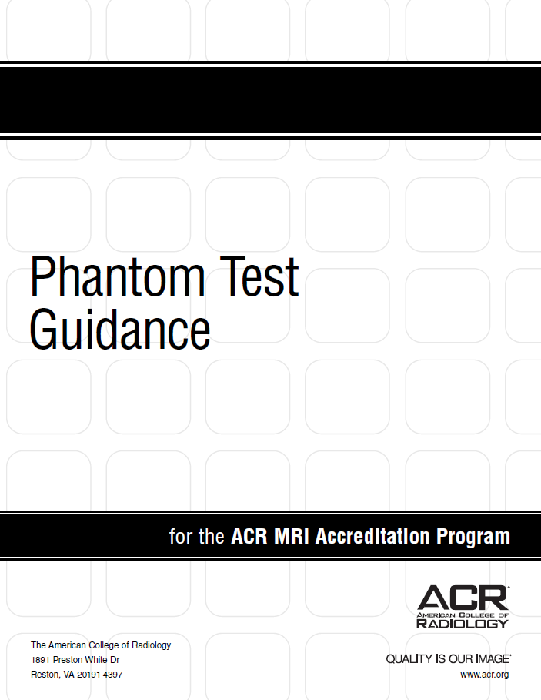
Well Documented

Slide 6
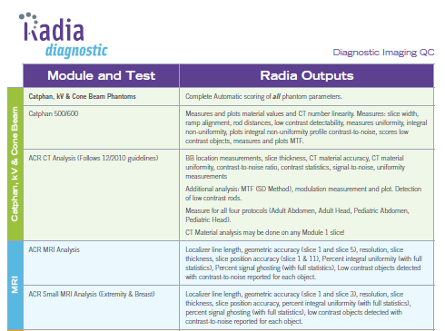

Available Software
http://www.jwpacific.com/radiadiag.html
http://www.onpointmd.com/index.php?option=com_content&view=article&id=47&Itemid=55

Slide 7
What does SAQA aim to achieve?
Free open-source script
Replace all the manual image window/level adjustment, length measurements, ROI generation, ROI area calculation, mean intensity calculation
Reduce error that is caused by manual process
Reduce physicist QA time
Source code possibly be implemented into other QA phantoms

Slide 8
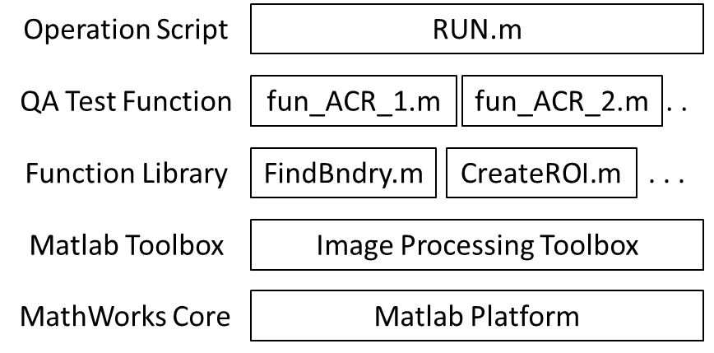
What is SAQA?
SAQA: semi-automatic QA

Slide 9
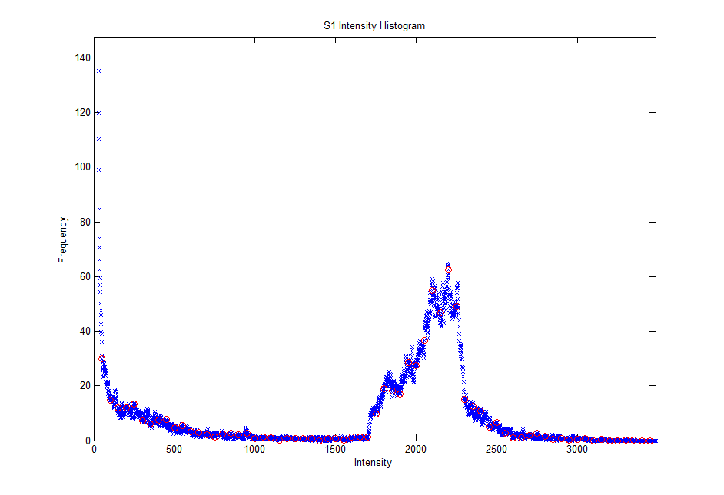


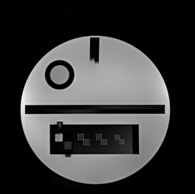
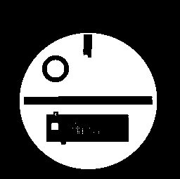

Image Thres. (Window/Level)
Slice position accuracy
Geometric distortion
Orig. image
Thres. image
Slice thickness accuracy

Slide 10
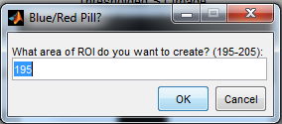
ROI Creation
Uniformity Test
Ghosting Test
ACR recommended area:
Area_{water}=195-205 cm²
Area_{air}=10 cm²
Area_{extreme}=1 cm²

Slide 11
Manual Process (Calvary Mater Hospital)
Manual QA initially made:
  ImageJ, NIH, USA
    Visualise DICOM image slices
    Manual thresholding image
    Manual measurements made using ruler and ROI tools
  Excel
    Documenting and report

Slide 12
Method: Manual vs. SAQA
Time for each method estimated
ACR criteria agreement
Manual vs. SAQA difference

Slide 13
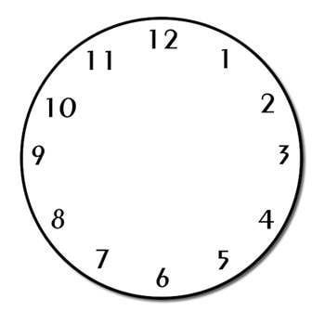
Time Conservation
Time:
  Manual: 45 mins + writing Excel report
  SAQA: 5 mins, report generated automatically

Slide 14
ACR Criteria Agreement
a
b
c

Slide 15
What can we do to make a better phantom?
Make sure the uniformity test slice is away from any inserted structure, for example one slice separation (e.g. S7)
Make critical structure away from the phantom edge (reduce the Gibb’s artefact, e.g. low contrast disk radius 3)
Make use of the grid on S5

Slide 16
What can we do to make a better phantom?
Make sure the uniformity test slice is away from any inserted structure, for example one slice separation (e.g. S7)
Make critical structure away from the phantom edge (reduce the Gibb’s artefact, e.g. low contrast disk radius 3)
Make use of the grid on S5

Slide 17
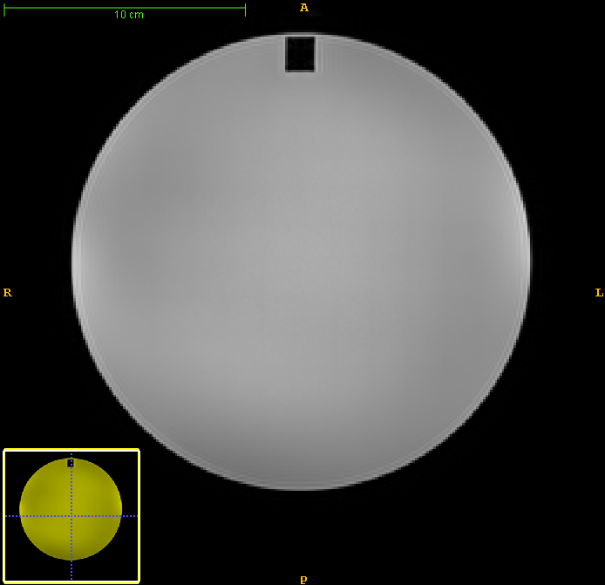
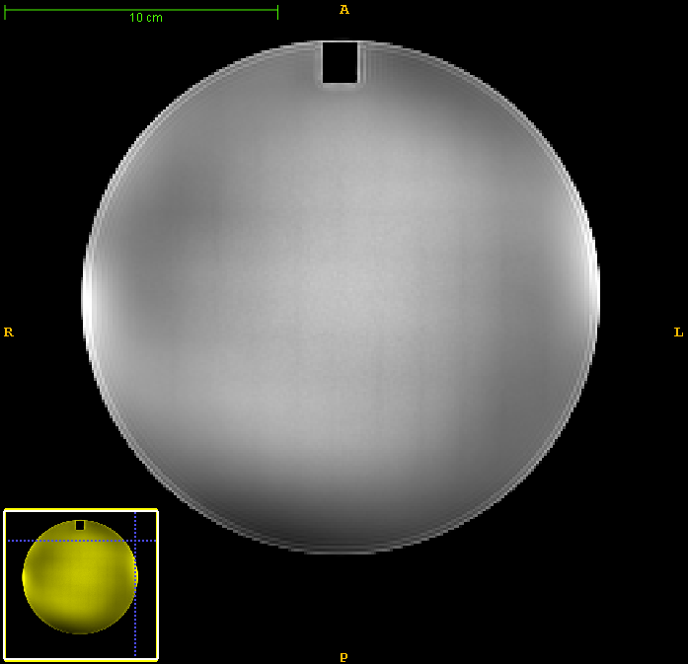


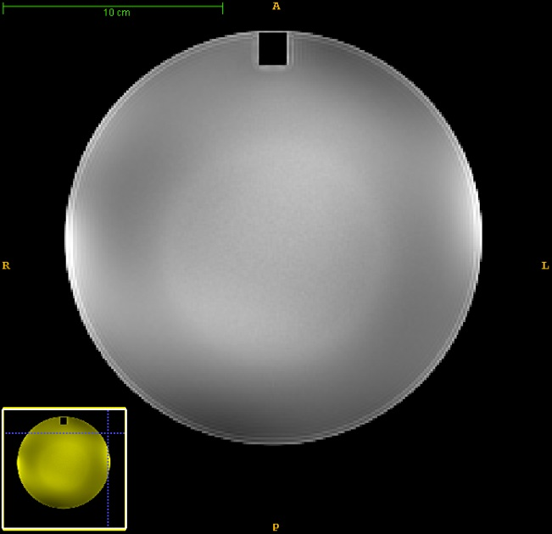
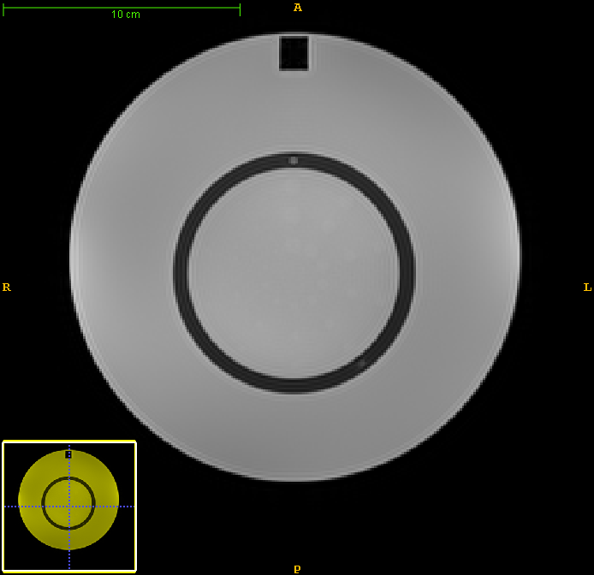
Uniformity Slice
S6
S6
S5
S7
S7
S8

Slide 18
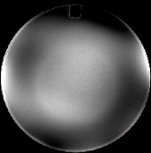
What’s wrong?
Problem:
Altered signal at the water and structure interface → underestimate PIU
Possible causes:
Slice positioning error (most depended factor)
Magnetic susceptibility artefact
Solution:
Increase the phantom length, so that a slice exists between the UNIFORMITY test slice and the nearby slices with inserted structures → (Slice 6.5)
S5
S6
S6.5
S7
S8

Slide 19
What can we do to make a better phantom?
Make sure the uniformity test slice is away from any inserted structure, for example one slice separation (e.g. S7)
Make critical structure away from the phantom edge (reduce the Gibb’s artefact, e.g. low contrast disk radius 3)
Make use of the grid on S5

Slide 20
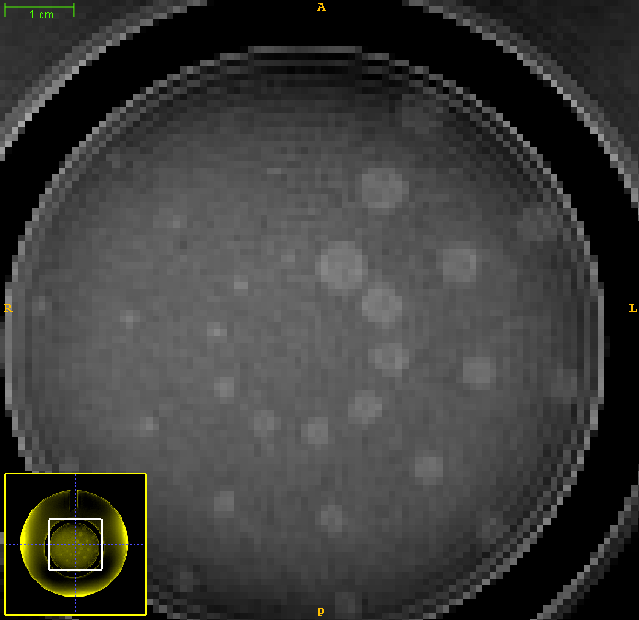
Edge Effect on Contrast Result

Slide 21
What can we do to make a better phantom?
Make sure the uniformity test slice is away from any inserted structure, for example one slice separation (e.g. S7)
Make critical structure away from the phantom edge (reduce the Gibb’s artefact, e.g. low contrast disk radius 3)
Make use of the grid on S5

Slide 22
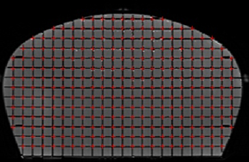
Geometric Distortion on S5
Implement grid cross-sections identification script from our pelvic phantom work last year into ACR MRI phantom to get the 2D distortion information

Slide 23
Conclusion
Most manual QA processes have been replaced by SAQA script
SAQA reduces QA time (45 mins →5 mins)
SAQA results comparable to manual results
Suggestions on making better QA phantom learned from ACR MRI phantom
Limitation of SAQA: high intensity external marker
Possibility to implement SAQA for other QA phantoms

Slide 24
Acknowledgement
Michael Barnes [MP], closely working together
Peter Stanwell [MR Physicist]
Jameen Arm, Leah Best, Melissa Murphy and Nick Marks [Radiographer]
Seeded region growth script written by Stéphane (http://www.mathworks.com.au/matlabcentral/fileexchange/35269-simple-single-seeded-region-growing) – used for low contrast disk masking

Slide 25
Thank you! ☺

